Slide 1
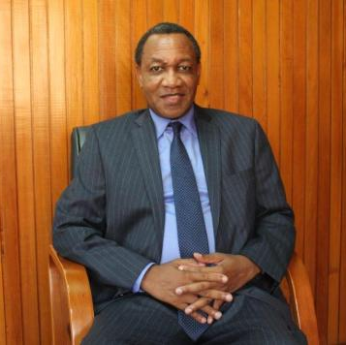
Building a Business Empire: What it takes
DR. THOMSON FRANK MPINGANJIRA
Group Chief Executive Officer
FDH Financial Holdings Limited
SUBSIDIARIES
FDH Bank Limited
First Discount House Limited
FDH Money Bureau Limited
FDH Financial Advisory Services Limited
MSB Properties Limited
“Building Enduring Organisations: Where We Stand, Where We Go”
ICAM Corporate Gurus Conference,
26 June 2019,
BICC, Lilongwe.

Slide 2
Building a business empire Introduction
The Guest of Honor Mr. Siphiwe Moyo
Fellow Speakers
ICAM CEO Dr. Francis Chinjoka Gondwe
Business Gurus and Participants
Ladies and Gentlemen
DR. T.F. MPINGANJIRA

Slide 3
Building a business empire Introduction
Good Morning Ladies and Gentlemen,
It is an honor to be invited to speak to this distinguished gathering today.
I have been asked to share with you my experience in building FDH Financial Holdings.
My focus will be on the hurdles and the opportunities and how the hurdles were overcome.
DR. T.F. MPINGANJIRA

Slide 4
Contents
Building a business empire
Background
Setting up a Discount House
Setting up a Bank & Acquisition of MSB Bank
Principles of building a business empire
Conclusion
DR. T.F. MPINGANJIRA

Slide 5
Building a business empire The Outcome
To inspire you to create your own business empire
DR. T.F. MPINGANJIRA

Slide 6
Building a business empire Background
I am a Chartered Accountant and Fellow of the Association of Chartered Certified Accountants(FCCA).
I worked for different companies including Deloitte, Blantyre Print, Mandala and National Bank of Malawi before setting up my own.
I was the first Malawian Stockbroker and was Chief Executive Officer (CEO) of Stockbrokers Malawi Limited from 1997 to 2000.
I was then tasked to set up the Malawi Stock Exchange and served as its first Chief Executive Officer from March 2000 to May 2002.
DR. T.F. MPINGANJIRA

Slide 7
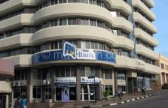
Building a business empire FDH Financial Holdings
FDH Financial Holdings Limited (FDHFHL) was established in November 2007 as part of the group restructuring to replace First Discount House, as the holding company of the group.
FDHFHL wholly owns the following subsidiaries:
First Discount House Limited – commenced operations April 2002.
FDH Bank Limited – Licensed 27 November 2007, operations commenced on 15 July 2008.
FDH Money Bureau Limited – commenced operations on 1 February 2009.
FDH Financial Advisory Services – commenced operations on 1 September 2009.
MSB Properties Limited – commenced operations in 2017.
We had FDH Stockbrokers from Jan 2007 but we shut it down as the cost of Compliance was higher that its revenues.
DR. T.F. MPINGANJIRA

Slide 8
Building a business empire FDH Financial Holdings
Employees over 800 people.
Its Bank, FDH Bank, has the widest service centre network – 50 service centres
Has a MK32.3 billion (US$44.47m) turnover.
Generates MK7.8 billion( 10.78m) profit after tax.
DR. T.F. MPINGANJIRA

Slide 9
Building a business empire
How did the building of FDH Financial Holdings begin?
DR. T.F. MPINGANJIRA

Slide 10
Setting up a discount house
My involvement with Stockbrokers Malawi and Malawi Stock Exchange revealed to me that there were vast opportunities and money to be made in the financial services sector in Malawi.
I started the process of setting up a Discount House while in full time employment at the Stockbrokers Malawi and Malawi Stock Exchange in December 1999 after chancing upon an opportunity following a discussion with my brother, Dr Peter Mpinganjira.
DR. T.F. MPINGANJIRA

Slide 11
Setting up a discount house
Setting up of a financial services business and running one is a very involving, nightmarish adventure.
All financial services entities are regulated by the Banking Act and supervised by the Reserve Bank of Malawi.
The capital and licensing requirements are a tall order.
In 1999 the minimum capital requirement was US$1.5 million in Malawi Kwacha equivalent.
At Mwk46.6667:USD1 the total was Mwk70,000,000.00. At todays rate of Mwk770 to USD1 the equivalent is Mwk1,155,000,000 or Mwk1.155 billion.
DR. T.F. MPINGANJIRA

Slide 12
Setting up a discount house
I invited four friends to join me so we were five of us to pool our resources and raise the USD1.5m capital.
Next I approached Malawi Development Corporation (MDC) to be our anchor institutional investor whose Board approved that MDC should partner FDH.
I hired my young brother, Dr Peter Mpinganjira, to put together a comprehensive business proposal. I paid him Mwk1,500,000 at the time.
This was needed in order to attract institutional investors including MDC.
DR. T.F. MPINGANJIRA

Slide 13
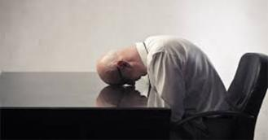
Setting up a discount house
On 6 March 2000 First Discount House was registered.
The next step was to apply for a license from the Reserve Bank of Malawi.
Between December 1999 and March 2000, for one reason or another, three of the four colleagues had bowed out of the idea. We were only two of us left.
By September 2000 I was left all alone.
DR. T.F. MPINGANJIRA

Slide 14
Setting up a discount house
In November 2000 I submitted the Licence application. MDC agreed to take up 55% of the shareholding while I remained with 45%.
The original plan had been that MDC takes 25% and the five of us take 15% each.
You can begin to understand just how terribly wrong the plan was going.
For over four months following that, there was to and fro correspondence between me and the Reserve Bank, as they sought to be satisfied that the application met the requirements.
I have files and files full of letters.
DR. T.F. MPINGANJIRA

Slide 15
Setting up a discount house
After the long drawn out discussion the Reserve Bank approved the license in principle.
As per the Law, the Minister of Finance had to give final approval of the licence.
On 5 April 2001, the then Minister of Finance, Dr. Matthews Chikaonda (now Late, MHSRIP), rejected the application on the grounds that the Government of Malawi had agreed with the IMF and World Bank to get out of the financial services sector, MDC was therefore not allowed to get into this new venture with me.
It was a deal breaker.
I was devastated.
Having toiled from December 1999.
DR. T.F. MPINGANJIRA

Slide 16
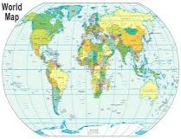
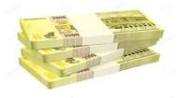
Setting up a discount house
The General Manager at RBM at the time said to me:
“ Don’t give up! Look across the borders as well. Don’t limit yourself to Malawi “
The RBM were very keen to have a second Discount House in Malawi, as at that stage there was only Continental Discount House.
By this time I had spent K5.4 Million cash from my personal money. Equivalent to Mwk89 Million today.
.
DR. T.F. MPINGANJIRA

Slide 17
Setting up a discount house
The search for investors started again in earnest in April 2001.
First I approached Old Mutual Malawi and Press Corporation in Malawi to partner with me but both turned me down. It was frustrating!
Giving up was not an option! I searched vigorously from Germany, South Africa, Zimbabwe, and all over.
I turned to my Stockbroking and Stock Exchange SADC and overseas contacts and these networks yielded results.
There is power in networking.
.
DR. T.F. MPINGANJIRA

Slide 18
Setting up a discount house
First, I had a powerful proposal.
Second, the fact that MDC had accepted the deal gave the proposal a lot of strength and credibility such that international organisations were interested to come in.
So when I emailed the proposal to Kingdom Financial Holdings Limited (Kingdom) in Zimbabwe and Old Mutual in Cape Town, they answered me the same day and said they were interested.
They immediately agreed to visit Malawi scheduling meetings within 30 days.
.
DR. T.F. MPINGANJIRA

Slide 19
Setting up a discount house
The shareholding and management arrangements were agreed.
Old Mutual insisted on bringing in Press Corporation on board but also on condition that I bring in Kingdom on board as a Technical partner seeing that neither me nor Old Mutual had run a Discount House before.
So we ended up with myself (24.9%), Old Mutual (20%), Kingdom (25.1%), and Press Corporation (30%).
There was very serious haggling to arrive at this split.
The irony is that both Old Mutual Malawi and Press Corporation in Malawi rejected me but at the behest of Cape Town they came on Board.
.
DR. T.F. MPINGANJIRA

Slide 20
Setting up a discount house
The resubmission for the application for the license was done on 11 June 2001 with the new shareholders.
The shareholders were: Dr TF Mpinganjira, Old Mutual, Press Corporation and Kingdom Foundation.
Finally on 20 July 2001, the RBM issued Banking License Number 0017.
The rest is history and, First Discount House opened its doors on 8 April 2002 and did its first trades on 11 April 2002.
.
DR. T.F. MPINGANJIRA

Slide 21
Setting up a discount house
At this stage, I was still in full time employment at the Malawi Stock Exchange.
To be able to set up the business while still in full time employment, I had sought and obtained, the Malawi Stock Exchange (MSE) Board’s approval to do so on these conditions:
No trading between MSE and Discount House unless prior approval is sought from the Board.
My involvement in the Discount House would be limited to sitting on the Board only.
We worked tirelessly and FDH grew rapidly.
.
DR. T.F. MPINGANJIRA

Slide 22
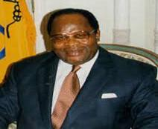
Setting up a discount house
In around 2001, my cousin Brown Mpinganjira had fallen out of grace with the UDF government.
He was fired from his job as a cabinet minister for leading the anti 3rd term Presidential bid.
My family was subsequently targeted.
My brother Dr Nathan Mpinganjira was fired from MDC at 15 minutes notice.
DR. T.F. MPINGANJIRA

Slide 23
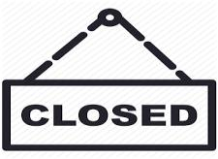
Setting up a discount house
My brother Dr Peter Mpinganjira had his internet business, Web and Internet Systems Services (WISS) shut down.
I knew I could not sustain my publicly funded job for too long.
I had to get out before I got fired so I resigned from my juicy MSE job of CEO and joined First Discount House on 1 June 2002.
The setting up of First Discount House had now became a do or die venture for me and failure was no longer an option.
DR. T.F. MPINGANJIRA

Slide 24
Setting up a discount house
The market was dominated by a long time giant, Continental Discount House; we simply could not penetrate it easily.
The Government of the day was very suspicious of First Discount House.
They thought we were just a front of my cousin’s political grouping, National Democratic Alliance (NDA).
.
DR. T.F. MPINGANJIRA

Slide 25
Setting up a discount house
On instructions from the authorities, we got no penny of business from Government or its related institutions.
Because of RBM’s Financial Services deepening drive at the time, our competitor had very favorable business conditions for the first four years of operation solely in the market.
We saw these incentives being withdrawn rapidly soon after we entered the Discount House market.
.
DR. T.F. MPINGANJIRA

Slide 26
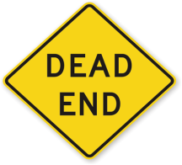
Setting up a discount house
Not surprisingly, within a short time our discount house business stagnated and plateaued becoming very clear that we were heading nowhere by December 2005.
At the next Board meeting I told the Board that we should diversify by following the Kingdom Zimbabwe model going into Banking and Stockbroking.
Press Corporation as a shareholder had serious objections because of their interest in National Bank of Malawi (NBM), as getting into banking would be direct competition to NBM.
.
DR. T.F. MPINGANJIRA

Slide 27
Setting up a discount house
On the other hand RBM gave us the green light to go into Banking as long as Press Corporation was out of First Discount House, as they could not be in two Banks having majority control in NBM.
The only way out was to buy out Press Corporation if we were to proceed with our diversification plans.
To cut a long story short, after one very heated Board meeting, we paid twice our original offer to Press Corporation for them to exit.
A total cost of Mwk100 Million in August 2006. Equivalent to Mwk557 Million at today’s rates.
So two shareholders, Kingdom and myself, bought out the 30% of Press Corporation while Old Mutual opted not to participate.
.
DR. T.F. MPINGANJIRA

Slide 28
Setting up a bank
After buying out Press Corporation, FDH needed US$1.5million Capital in cash in order to apply for a banking licence.
I convinced the Board that listing First Discount House was an option to consider.
By Listing FDH would be selling new shares at the Malawi Stock Exchange and use the proceeds to capitalize the Bank.
At this point in time US$1.5 Million was equivalent to Mwk215 Million. Exchange rate had moved to Mwk143.3333 to 1 US$.
.
DR. T.F. MPINGANJIRA

Slide 29
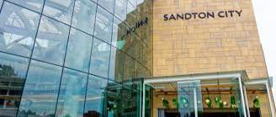
Setting up a bank
While we were contemplating setting up the Bank, we got word that Nedbank South Africa was rationalizing its African operations and Nedbank Malawi would be on sale.
We quickly contacted Nedbank SA, did due diligence and flew to Sandton to finalise Sale agreements.
Just as we were ready to put pen to paper the deal was put on hold following concerns raised by the newly appointed Nedbank Africa Regional Head.
We abandoned that process promptly. This was in 2006.
Meanwhile in January 2007 we quickly set up FDH Stockbrokers Malawi while still working on the establishment of a Bank.
.
DR. T.F. MPINGANJIRA

Slide 30
Setting up a bank
Having abandoned the Nedbank acquisition, the listing process commenced in earnest.
The Malawi Stock Exchange granted Provisional approval for the listing process including the listing date full details were:
Offer opens: Monday, 9 July 2007 at 08:00
Offer closes: Friday, 3 August 2007 at 15:00
Proposed listing date: Monday, 13 August 2007
The initial public offering (IPO) was for the subscription of 205,714,286 ordinary shares of a nominal value of 25 tambala each in the share capital of First Discount House Limited at an offer price of MWK1.30 per share. We were therefore planning to raise Mwk267, 428,572.00.
Transactions Advisors were appointed, Prospectuses were printed, the IPO launch date was set, invitations were sent out and excitement was very high and everything was moving right.
.
DR. T.F. MPINGANJIRA

Slide 31
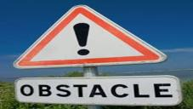
Setting up a bank
Then Murphy’s Law hit: “If anything can go wrong it will always go wrong”. So it did.
A day before the IPO launch date of 4 July 2007, I received a letter from the Malawi Stock Exchange that the “FINAL” approval had not been granted by the Board of the Malawi Stock Exchange to proceed with the Listing!!!.
The launch and listing could not go ahead.
At this stage we had already set everything up including the printing of 3,000 prospectuses, the venue Mount Soche Hotel paid for, Invitations sent out to 300 guests etc.
.
DR. T.F. MPINGANJIRA

Slide 32
Setting up a bank
At that stage fees and costs already committed and paid or yet to be paid totaled Mwk23,790,920.33.
And that went down the drain just like that!!!
This figure ended up at Mwk26 Million by the time all bills had been paid.
That was the biggest frustration ever in my life.
I just wanted the earth to open up and swallow me fully knowing the reputation consequences for me personally and the First Discount House brand.
.
DR. T.F. MPINGANJIRA

Slide 33
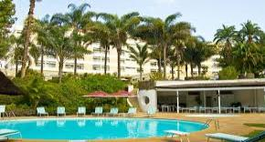
Setting up a bank
My Personal Assistant had to call around 300 guests to inform them of the cancellation of the listing and the IPO launch cocktail at Mount Soche Hotel the following day.
Needless to say she could not manage to reach all invited guests.
Even though we placed newspaper adverts we still did not reach everybody.
A lot of guests showed up for the aborted Cocktail.
It was a huge embarrassment.
I had to cancel the hotel booking for the event and call off all the other arrangements which had already been finalised.
.
DR. T.F. MPINGANJIRA

Slide 34
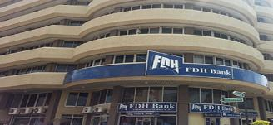
Setting up a bank
For the following 5 working days from July 9 2007 I went to the office, locked myself up and sat and did nothing, failing to face my Board, Employees and the Public.
I remembered my favorite verse Romans 8:28, got over this and as they say, the rest is history.
We went back to the drawing board and got a banking license on the 27 November 2007 and the FDH Bank opened for business on the 15 July 2008.
The shareholders loaned MWk215 million to FDH Financial Holdings Limited for the Capital.
Our bank has been growing since and the story of FDH Bank is now well documented.
.
DR. T.F. MPINGANJIRA

Slide 35
Expanding the bank: Acquisition of MSB Bank
The justification for acquiring MSB Bank:
FDH Bank had a big dream – Vision to lead in Malawi and Southern Africa.
Needed a huge customer deposit base.
Needed a huge network of branches to drive a digital strategy and penetrate the rural areas.
Needed scale to favorably compete for Government, International and Local non-government organisations.
To achieve this growth organically it was projected we would take up to 10 years. So we went for MSB.
DR. T.F. MPINGANJIRA

Slide 36
Acquisition of MSB Bank: The Hurdles
The Due Diligence process:
38 bidders attended the conference and only one submitted a bid for MSB Bank – FDH Bank.
There were no audited accounts to use to prepare Technical and Financial Bids/Proposals
There was inadequate information in the Data Room for due diligence and valuation purposes.
DR. T.F. MPINGANJIRA

Slide 37
Acquisition of MSB Bank: The Hurdles
Misconceptions of the value of MSB Bank:
Lack of expertise from Analysts writing and commenting about the valuation - focusing on its balance sheet and deposit base (yet deposits belong to customers and are not the shareholders equity).
The Resident IMF Country Director in 2015 was surprised that we paid Mwk5.4 Billion.
His view was that the MSB Bank was worth Mwk1.00. And he was damn right!!!
DR. T.F. MPINGANJIRA

Slide 38
Acquisition of MSB Bank: The Hurdles
Propaganda, fake news and misinformation
Contrary to MK1 billion profit declared by Management, Audited Accounts showed a MK2 Billion loss.
Over 70% of non-performing loans and MK48 billion written down from MSB Bank Loan Books from 2015 to 31 December 2018
DR. T.F. MPINGANJIRA

Slide 39
Building a business empire
From the above, what are some of the principles for building a business empire?
DR. T.F. MPINGANJIRA

Slide 40
Building a business empire
Put God first-The Bible: The Best Success Manual
All wealth comes from God, whether people accept this reality or not.
God gives us the power and means to create and the opportunity to manage it for Him.
Requires a spiritual return on investment (SROI).
DR. T.F. MPINGANJIRA

Slide 41
Building a business empire
Put God first- Spiritual Return on Investment(SROI)
Launched the MK150 million University of Malawi Students Scholarships.
DR. T.F. MPINGANJIRA

Slide 42
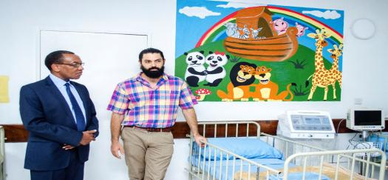
Building a business empire
Put God first- Spiritual Return on Investment(SROI)
MK15 million rehabilitation and refurbishment of Malamulo Pediatric Ward Project in Makwasa. A High Dependency Unit, HDU.
DR. T.F. MPINGANJIRA

Slide 43
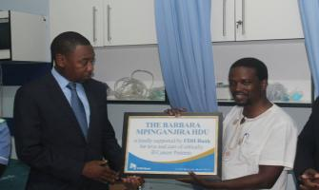
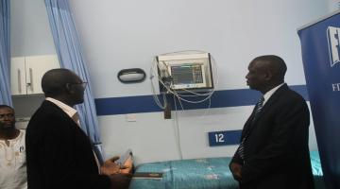
Building a business empire
Put God first- Spiritual Return on Investment(SROI)
The Barbara Mpinganjira High Dependency Cancer Unit at the Queen Elizabeth Central Hospital. And fully sponsored to paying 3 nurses and maintaining all equipment. In addition to proving transport for patients.
DR. T.F. MPINGANJIRA

Slide 44
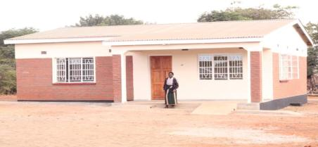
Building a business empire
Put God first- Spiritual Return on Investment(SROI)
Built a MK14 million house for Mai Marietta Samuel in Nambuma, Dowa.
DR. T.F. MPINGANJIRA

Slide 45
Building a business empire
Have a Vision (dream).
Vision is requisite to success e.g. in Education or in Business
Our vision - To be leading provider of first class financial solutions in Malawi and Southern Africa.
DR. T.F. MPINGANJIRA

Slide 46
Building a business empire
Make a plan
Read about successful businesspersons and come up with your own plan
A successful business plan is simple and smart and will take you to greater heights.
DR. T.F. MPINGANJIRA

Slide 47
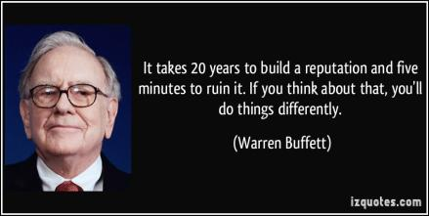
Building a business empire
Be ethical in all your dealings
Your reputation is the quickest way into high places in business and society. Mess up once and you are finished. That is how one email to Old Mutual Cape Town and Kingdom Zimbabwe brought in two international shareholders into FDH.
Ethical behavior has to be a lifestyle.
DR. T.F. MPINGANJIRA

Slide 48
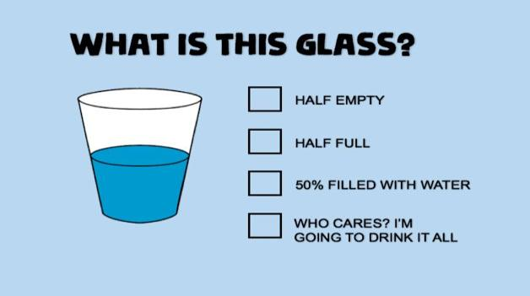
Building a business empire Be an opportunist
.
Pessimist
- PERSIMISTS
Optimist
- OPTIMISTS
Realist
- REALIST
Opportunist
- OPPORTUNIST
- BE AN OPPORTUNIST, TAKE ACTION!
DR. T.F. MPINGANJIRA

Slide 49
Building a business empire
Develop a winners mentality
BEHAVIOUR OF WINNERS | BEHAVIOUR OF LOSERS
Listen & Learn and ask questions | Talk big, usually about what they plan to do some day, don’t listen
Discuss opportunities and figure out solutions to problems | Complain about problems
Repeat behaviors that work | Repeat behavior that has brought failure and avoid trying anything new for fear that even worse failure will result
Practice goal setting on a regular basis | Depend on luck and chance for any success
DR. T.F. MPINGANJIRA

Slide 50
Building a business empire
Build your trusted team
Identify sets of skills and attitude that can support the culture of the brand you want to build.
DR. T.F. MPINGANJIRA

Slide 51
Building a business empire
Take gradual steps to grow the business
Take smaller risks in the beginning and adjust growth gradually.
Forget big goals; take gradual steps for small, daily wins.
DR. T.F. MPINGANJIRA

Slide 52
Building a business empire
Overcoming challenges
You will hit many walls, you will fall many times, people will laugh at you but you must remain steadfast in your goals.
“Pick yourself up, dust yourself up and start all over again (Peter Tosh).
Never give up.
DR. T.F. MPINGANJIRA

Slide 53
Building a business empire Source of Inspiration
My greatest mentor was my father who ran a successful import and export business for many years.
My classic inspiration comes from the Asian Community, who initially came to Malawi in the early 1900s to build the railway line from Nsanje to Limbe.
They started businesses from their terminal dues and loans and grew them and most of the first generation Asians have since died, but their businesses are still thriving and their Children, grandchildren and great grandchildren are still running and even growing those businesses.
.
DR. T.F. MPINGANJIRA

Slide 54
Building a business empire Source of Inspiration
.
However for most Malawians, their businesses do not live any longer than the life time of the people that started them. Even worse only survive a political regime.
My driving passion has been to leave a legacy for my family.
Build businesses that endure.
DR. T.F. MPINGANJIRA

Slide 55
Building a business empire Conclusion
No one formula for building a business empire: key risk taking.
The keys principles include the following:
Put God first in everything. Romans 8:28.
A Big Dream.
A Plan.
Be an opportunist.
Winning mentality.
Be ethical in all your dealings.
Above all, plan to leave behind a Legacy.
DR. T.F. MPINGANJIRA

Slide 56
DR. T.F. MPINGANJIRA

