Slide 1
HARMONISING AFRICA’S RESOURCES FOR AFRICA’S DEVELOPMENT: FROM THIRD WORLD TO FIRST
PRESENTED BY:
PROF. PLO LUMUMUMBA
AT SUN N SAND, MANGOCHI, MALAWI
ON 21ST DAY OF SEPTEMBER, 2019

Slide 2
HARMONISING AFRICA’S RESOURCES FOR AFRICA’S
DEVELOPMENT: FROM THIRD WORLD TO FIRST
CONTENT OUTLINE
INTRODUCTION
MAP OF MAJOR RESOURCES MINED IN AFRICA
AFRICAN RESOURCES
CHALLENGES TO AFRICA’S GROWTH & DEVELOPMENT
MOST OF THE PRESSURES THAT COME TO BEAR ON THE AFRICAN ECONOMY
PRACTICAL APPROACHES AND STRATEGIES OF HARMONISING AFRICA'S RESOURCES FOR AFRICA'S DEVELOPMENT.
TRENDS TOWARDS PROSPERITY.
THE ROLE OF PROFESSIONALS IN GROWTH AND THE DEVELOPMENT OF AFRICA
CONCLUSION

Slide 3
HARMONISING AFRICA’S RESOURCES FOR AFRICA’S
DEVELOPMENT: FROM THIRD WORLD TO FIRST
INTRODUCTION
African continent is endowed with enormous resources. There are vast mineral deposits.
The fathers of the continent; the pan Africanists, had a dream for the continent.
They envisioned a continent that was united, prosperous, highly developed and peaceful, one that was ahead if not an equal partaker in world business with the rest of the world, a continent with capacity to give aid to other continents.

Slide 4
HARMONISING AFRICA’S RESOURCES FOR AFRICA’S DEVELOPMENT: FROM THIRD WORLD TO FIRST
INTRODUCTION CONT.….
Yet, fifty years down the line, Africa still wallows social, economic and political instabilities. It still relies heavily on donations from other continents.
The dreams of Pan-Africanists are yet to be realised. However, Africa boasts of increased professionals in different sectors since independence.

Slide 5
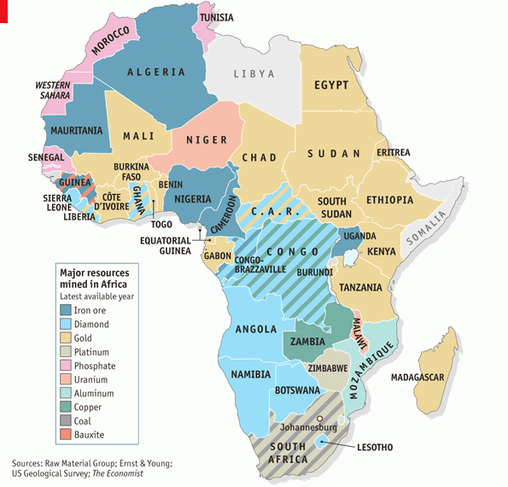
MAP OF MAJOR RESOURCES MINED IN AFRICA
Sources: Raw Material Group; Ernst & Young: US Geological Survey; The Economist in 2015

Slide 6
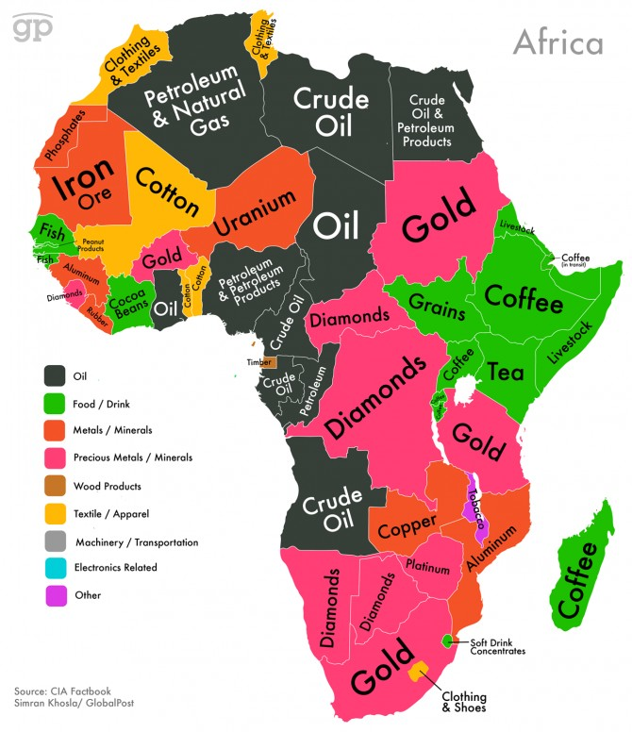
MAP OF AFRICAN RESOURCES CONT…
Published in 2017
Published in 2017
Source: CIA Factbook by Simran Khosla,Published in 2014

Slide 7
HARMONISING AFRICA’S RESOURCES FOR AFRICA’S DEVELOPMENT: FROM THIRD WORLD TO FIRST
AFRICAN RESOURCES
Africa is a home to an abundance of natural resources that include diamonds, gold, oil, natural gas, uranium, platinum, copper, cobalt, iron, bauxite, silver, and more.
Human Resource: which includes the skills, intelligence, and knowledge, and use technology to transform a natural resource into usable and valuable things, they themselves become a resource.
The continent still has a great deal of untapped resources the deposits are so abundant that some of it are yet to be discovered.

Slide 8
HARMONISING AFRICA’S RESOURCES FOR AFRICA’S DEVELOPMENT: FROM THIRD WORLD TO FIRST
AFRICAN RESOURCES CON’T
The sad reality is that Africa’s wealth has been its curse. The minerals of Democratic Republic of Congo should have been a source of livelihood, wealth and happiness for its inhabitants, instead, the rich gold deposits have turned into fields of mass murders and rapes as different group’s battle for the reserves.
The oil of Nigeria should have long turned the country into a developed delta after the likes of “Dubai”, that we see are state oil wells in the hands of, and exploited largely for the benefit of corrupt leaders who stash billions in foreign lands.

Slide 9
HARMONISING AFRICA’S RESOURCES FOR AFRICA’S
DEVELOPMENT: FROM THIRD WORLD TO FIRST
CHALLENGES TO AFRICA’S GROWTH & DEVELOPMENT
Food Insecurity
Reliance On Foreign Aid
Poor Infrastructure
Poor Human Resource Capacity
Fragmented Industrial Sector
Corruption

Slide 10
HARMONISING AFRICA’S RESOURCES FOR AFRICA’S
DEVELOPMENT: FROM THIRD WORLD TO FIRST
FOOD INSECURITY
The neglect of the food sector over the last two decades, which has resulted in an unprecedented food crisis
There is no doubt that the droughts in Africa have contributed to the worsening of the overall domestic food supply situation.
However, it has been repeatedly emphasized that there are basic structural factors that have negatively affected food production. These include, inter alia, a bias against agriculture in government policy; high population growth; fast reduction in arable land and harvested area; and a lack of the technological change to increase agricultural productivity.

Slide 11
HARMONISING AFRICA’S RESOURCES FOR AFRICA’S
DEVELOPMENT: FROM THIRD WORLD TO FIRST
RELIANCE ON FOREIGN AID
Despite the vast human capital and natural resources, African countries continued to rely on foreign aid soon after independence.
In the past fifty years, more than $1 trillion has been pumped into Africa as foreign aid yet poverty levels continue to escalate and growth rates have steadily declined—and millions continue to suffer. (Dambisa Moyo, Dead Aid, 2009)

Slide 12
HARMONISING AFRICA’S RESOURCES FOR AFRICA’S
DEVELOPMENT: FROM THIRD WORLD TO FIRST
RELIANCE ON FOREIGN AID CONT….
Money from rich countries has trapped many African nations in a cycle of corruption, slower economic growth and poverty.
More aid will only encourage the trend, established by rich countries, that relieves African governments of their responsibility to provide healthcare and education. As Meredith says, aid has already discredited itself. Since independence, Africa has received $300bn of Western aid - more than any other region - with no discernible results.

Slide 13
HARMONISING AFRICA’S RESOURCES FOR AFRICA’S
DEVELOPMENT: FROM THIRD WORLD TO FIRST
POOR INFRASTRUCTURE
The lack of adequate infrastructures constitutes another basic characteristic of African countries.
The inadequacy and poor conditions of Africa’s transport and communications infrastructures coupled with the inefficiency of the related services is a major impediment to the expansion of economic activities within and among African countries.

Slide 14
HARMONISING AFRICA’S RESOURCES FOR AFRICA’S
DEVELOPMENT: FROM THIRD WORLD TO FIRST
POOR HUMAN RESOURCE CAPACITY
Inadequate development and utilization of human resources greatly impede the grand march to the promised land of the African dream.
The high population growth rate in Africa would not have had the present negative impact if the actions called for in the Lagos Plan of Action had been implemented, to the extent that Africa would have achieved a satisfactory level of self-reliance in trained and technical manpower. Instead, there is a dramatic shortage of skilled manpower especially in key areas essential for economic recovery.

Slide 15
HARMONISING AFRICA’S RESOURCES FOR AFRICA’S
DEVELOPMENT: FROM THIRD WORLD TO FIRST
FRAGMENTED INDUSTRIAL SECTOR
Enclaved and fragmented industrial sector is another challenge to the realization of the African dream.
The failure of the industrial sector in Africa to become a complementary or alternative engine of growth to agriculture and mining is another major challenge for the economic recovery of the region.

Slide 16
HARMONISING AFRICA’S RESOURCES FOR AFRICA’S
DEVELOPMENT: FROM THIRD WORLD TO FIRST
CORRUPTION
Corruption has become so pervasive and pernicious that it has become a way of life. The root causes of corruption vary from place to place depending on the political, social, economic and cultural circumstances
In all African countries, one can say hyperbolically, that the corrupt are canonized and anti-corruption warriors are demonized. The best that Africa does is what the great Greek Philosopher Aesop said, “They hang the petty thieves and elect the great ones into public offices.”
Corruption therefore has affected the growth and development of Africa.

Slide 17
HARMONISING AFRICA’S RESOURCES FOR AFRICA’S
DEVELOPMENT: FROM THIRD WORLD TO FIRST
MOST OF THE PRESSURES THAT COME TO BEAR ON THE AFRICAN ECONOMY
The collapse in internal prices of primary commodities
the structural contraction in world trade, the decrease in official development assistance in net terms
Increased protectionism in industrialized countries

Slide 18
HARMONISING AFRICA’S RESOURCES FOR AFRICA’S
DEVELOPMENT: FROM THIRD WORLD TO FIRST
MOST OF THE PRESSURES THAT COME TO BEAR ON THE AFRICAN ECONOMY CONT…
The volatility in the exchange rates of major currencies resulting in a consistent decline of the value of the United States dollar which is the currency used in paying for Africa’s exports;
High interest rates, high prices of imported manufactured goods and services; and, above all, the high level of Africa’s external indebtedness, as major constraints to a speedy economic recovery and sustained development in Africa.

Slide 19
HARMONISING AFRICA’S RESOURCES FOR AFRICA’S
DEVELOPMENT: FROM THIRD WORLD TO FIRST
PRACTICAL APPROACHES AND STRATEGIES OF HARMONISING AFRICA'S RESOURCES FOR AFRICA'S DEVELOPMENT
Governance Structure: There is need to establish a governance structure that promotes good governance in Africa. The structure must conform to the dictates of the principles of constitutionalism, separation of powers and the rule of law.
The structure should provide for checks and balances’ including the independence of the judiciary as this is one of the surest ways of ensuring transparency and accountability in the management of public affairs, law enforcement as well as good governance.

Slide 20
HARMONISING AFRICA’S RESOURCES FOR AFRICA’S
DEVELOPMENT: FROM THIRD WORLD TO FIRST
    PRACTICAL APPROACHES AND STRATEGIES OF HARMONISING AFRICA'S RESOURCES FOR AFRICA'S DEVELOPMENT CONT….
Policy Reforms: African countries need to develop policies to guide the anti-corruption legislative and administrative actions and processes which would ultimately promote good governance. It is worth of noting that many African countries are yet to develop anti-corruption policies or review the existing policies to bolster the fight against corruption.
Legislative and Institutional: The African countries should strive to review their legal and institutional frameworks in order to make corruption a high risk venture with negative returns

Slide 21
HARMONISING AFRICA’S RESOURCES FOR AFRICA’S
DEVELOPMENT: FROM THIRD WORLD TO FIRST
    PRACTICAL APPROACHES AND STRATEGIES OF HARMONISING AFRICA'S RESOURCES FOR AFRICA'S DEVELOPMENT CONT….
Public Service Reforms: The public service in Africa including the operational framework should be reviewed in order to improve service delivery and enhance good governance.
Citizen Empowerment and Participation: Empowerment entails giving a voice to the people to determine issues that affect their lives. It enables citizens to expand their authority and control over resources and decisions that affect them. The key to empowerment and participation can be found in building knowledge base and skills for more effective participation and organisational capacity.

Slide 22
HARMONISING AFRICA’S RESOURCES FOR AFRICA’S
DEVELOPMENT: FROM THIRD WORLD TO FIRST
    PRACTICAL APPROACHES AND STRATEGIES OF HARMONISING AFRICA'S RESOURCES FOR AFRICA'S DEVELOPMENT CONT….
International Co-operation: The transnational nature of corruption necessitates cooperation within and outside states. In the case of Africa, the member states have to cooperate to develop and enforce anti-corruption and good governance strategies and processes to make it difficult to engage in corruption or hide corruptly acquired wealth.
Stakeholders Synergy: The fight against corruption requires the involvement of every stakeholder in society. Accordingly for African countries to succeed in addressing the problem of corruption, they need to harness the available resources and synergise the efforts of all stakeholders in the process

Slide 23
HARMONISING AFRICA’S RESOURCES FOR AFRICA’S
DEVELOPMENT: FROM THIRD WORLD TO FIRST
TRENDS TOWARDS PROSPERITY
Africa has recognise Her weakness and although She maybe making baby-steps against many head wins the Nkurumahist exhortation “forward ever backward never” must be critical.

Slide 24
HARMONISING AFRICA’S RESOURCES FOR AFRICA’S
DEVELOPMENT: FROM THIRD WORLD TO FIRST
REGIONAL ORGANISATION
1. Economic Community of West Africa States (ECOWAS) comprising fifteen member states, namely: Benin, Burkina Faso, Cape Verde, Cote D’Ivoire, Gambia, Ghana, Guinea, Guinea Bissau, Liberia, Mali, Niger, Nigeria, Senegal, Sierra Leone, Togo.
Its mission is to promote economic integration in all fields of economic activity, particularly industry, transport, telecommunications, agriculture, natural resources, commerce, monetary and financial questions and social and cultural matters.

Slide 25
HARMONISING AFRICA’S RESOURCES FOR AFRICA’S
DEVELOPMENT: FROM THIRD WORLD TO FIRST
(A) REGIONAL ORGANISATION CONT…
2. Southern African Development Community (SADC) comprising fifteen member states namely: Angola, Botswana, Democratic Republic of Congo (DRC), Lesotho, Madagascar, Malawi, Mauritius, Mozambique, Namibia, Seychelles, South Africa, Swaziland, United Republic of Tanzania, Zambia and Zimbabwe.
SADC sets to ‘promote sustainable and equitable economic growth and socio-economic development that will ensure poverty alleviation with the ultimate objective of its eradication, enhance the standard and quality of life of the people of Southern Africa and support the socially disadvantaged through regional integration.

Slide 26
HARMONISING AFRICA’S RESOURCES FOR AFRICA’S
DEVELOPMENT: FROM THIRD WORLD TO FIRST
REGIONAL ORGANISATION CONT…
3. East African Community (EAC) with six member states namely: Kenya, Uganda, Tanzania, Burundi, Rwanda and South Sudan.
EACs objectives are to develop policies and programs aimed at widening and deepening cooperation on political, economic, social and cultural fields, research and technology, defense, security and legal and judicial affairs

Slide 27
HARMONISING AFRICA’S RESOURCES FOR AFRICA’S
DEVELOPMENT: FROM THIRD WORLD TO FIRST
REGIONAL ORGANISATION CONT…
4. Inter-Governmental Authority for Development (IGAD) with eight member namely: Djibouti, Ethiopia, Eritrea, Kenya, Somalia, South Sudan, Sudan, and Uganda.
IGAD aims to promote joint ‘joint development strategies and gradually harmonize macro-economic policies and programs in the social, technological and scientific fields. More specifically, IGAD seeks to ‘harmonize policies with regard to trade, customs, transport, communications, agriculture and natural resources , and promote free movement of goods, services and people, and the establishment of residence.

Slide 28
HARMONISING AFRICA’S RESOURCES FOR AFRICA’S
DEVELOPMENT: FROM THIRD WORLD TO FIRST
REGIONAL ORGANISATION CONT…
5. Economic Community of Central African States (ECCAS) comprising of eleven (11) member states namely: Angola, Burundi, Cameroon, Congo, Central African Republic, Democratic Republic of Congo, Gabon, Equatorial Guinea, Chad, Rwanda and Sao Tome and Principe.
ECCAS aims to ‘promote and strengthen harmonious cooperation and balanced and self-sustained development in all fields of economic and social activity, particularly in the fields of industry, transport and communications, energy agriculture, natural resources, trade, customs, monetary and financial matters, human resources, tourism, education, culture, science and technology and the movement of persons.

Slide 29
HARMONISING AFRICA’S RESOURCES FOR AFRICA’S
DEVELOPMENT: FROM THIRD WORLD TO FIRST
(B) AGENDA 2063
It cannot be denied that for the last 50 years, many African countries have continued to punch below their weight in critical areas of economy, politics and social cohesion. Indeed many Africans now begin to question whether they will ever reap the dividends of independence. An unguarded conversation with a African in the rural areas and even the poorer parts of the urban areas in many African countries but more particularly in countries such as South Sudan, Somalia, Eritrea, The Gambia and Central African Republic to mention a few reveals the disillusioned.
It is on the basis of this realization that African heads of states and governments sitting in Addis Ababa, Ethiopia endorsed the Africa Agenda 2063 under the emblematic clarion call ‘The Africa we want.’

Slide 30
HARMONISING AFRICA’S RESOURCES FOR AFRICA’S
DEVELOPMENT: FROM THIRD WORLD TO FIRST
AGENDA 2063 CONT…
The Agenda 2063 articulates the aspirations of the continent in the following:
A prosperous Africa based on inclusive growth and sustainable development
An integrated continent, politically united and based on the ideals of Pan-Africanism and the vision of Africa’s Renaissance
An Africa of good governance, democracy, respect for human rights, justice and the rule of law
A peaceful and secure Africa
An Africa with a strong cultural identity, common heritage, shared values and ethics
An Africa whose development is people-driven, relying on the potential of African people, especially its women and youth, and caring for children
Africa as a strong, united and influential global player and partner

Slide 31
HARMONISING AFRICA’S RESOURCES FOR AFRICA’S
DEVELOPMENT: FROM THIRD WORLD TO FIRST
(C) COOPERATION AMONG COUNTRIES
Countries cooperate with each other in thousands of ways through international Organisations, treaties, and consultations. Such cooperation generally encourages the globalization of business by eliminating restrictions on it and by outlining frameworks that reduce uncertainties about what companies will and will not be allowed to do. Countries cooperate:

Slide 32
HARMONISING AFRICA’S RESOURCES FOR AFRICA’S
DEVELOPMENT: FROM THIRD WORLD TO FIRST
(D) THE EMPHASIS ON SCIENCE AND TECHNOLOGY
Science and technology has improved managerial practices, organizational change in the production of goods and services.
Increased investments in information and communications technology (ICT) have led to improved quality of capital and labour as we witness the rising skills of the average worker in African economies. Technological change obtained through the returns to research and development and other knowledge-based investments and spillovers from innovation also contribute importantly towards growth.

Slide 33
HARMONISING AFRICA’S RESOURCES FOR AFRICA’S
DEVELOPMENT: FROM THIRD WORLD TO FIRST
(E) THE 4TH INDUSTRIAL REVOLUTION
The 4th industrial revolution which its aim is to have digitally smart factories, cities and entire economies connected to the Internet to boost growth and development of Africa.
It has the potential to impact on all industries and all nations, regardless of their location or state of development

Slide 34
HARMONISING AFRICA’S RESOURCES FOR AFRICA’S
DEVELOPMENT: FROM THIRD WORLD TO FIRST
THE ROLE OF PROFESSIONALS IN GROWTH AND THE DEVELOPMENT OF AFRICA
Professionals falls into the classic Western trap of over-using statistics. Figures are important, but the statistics that obsess us about Africa tell only part of the story because of census fraud, regional rivalries and the aid agencies' own tendency to overstatement.
Most African professionals lack integrity. For Africa to realise her full potential, professionals must assume accountability and play active role geared towards achieving the growth of Africa.

Slide 35
HARMONISING AFRICA’S RESOURCES FOR AFRICA’S
DEVELOPMENT: FROM THIRD WORLD TO FIRST
THE ROLE OF PROFESSIONALS IN GROWTH AND THE DEVELOPMENT OF AFRICA CONT…
The professionals in Africa must participate in and put the governments into tasks by:
Enhancing the fight against corruption and strengthening the anti-corruption systems and already in places
Developing effective, accountable and transparent institutions at all levels of government to ensure that service delivery is effected to all citizens
Ensuring responsive, inclusive, participatory and representative decision-making at all levels by the public to increase public trust, transparency and accountability;

Slide 36
HARMONISING AFRICA’S RESOURCES FOR AFRICA’S
DEVELOPMENT: FROM THIRD WORLD TO FIRST
THE ROLE OF PROFESSIONALS IN GROWTH AND THE DEVELOPMENT OF AFRICA CONT…
The professionals must identify and participate in eliminating threats that stand in the way of African progress including corruption, bad leadership, greed and general apathy. Only then can we chart a workable roadmap to the promised land of hope and prosperity.
Ensuring public access to information and protecting fundamental freedoms in accordance with the national legislation and international instruments

Slide 37
HARMONISING AFRICA’S RESOURCES FOR AFRICA’S
DEVELOPMENT: FROM THIRD WORLD TO FIRST
CONCLUSION
The African dream must therefore depart from her mythical conclave of merely an unattainable mirage and proceed to the precincts of a reality that can be achieved if only each one of us did what is required to sow the seeds, nurture the dream, talk the talk and walk the walk of a developed integrated Africa. The African dream envisages a continent thriving on the cardinal creed of peace, democracy, development, which is at par with or even above the rest of the world in human and economic development.

Slide 38
HARMONISING AFRICA’S RESOURCES FOR AFRICA’S
DEVELOPMENT: FROM THIRD WORLD TO FIRST
CONCLUSION CONT….
The beginning point towards realization of this dream involves the identification of the threats that stand in the way of the dream including corruption, bad leadership, greed, and general apathy; which in turn breed violence in hearts of men and chaos, turmoil and war in the societies as a whole. Only then can we chart a workable road map to the promised land of hope and prosperity

