Slide 1
Ronald Mangani Department of Economics, University of Malawi
Remodeling The Economy Into Shape: The Economic Chisels We Need
2021 ICAM Lakeshore Conference
17 September 2021

Slide 2
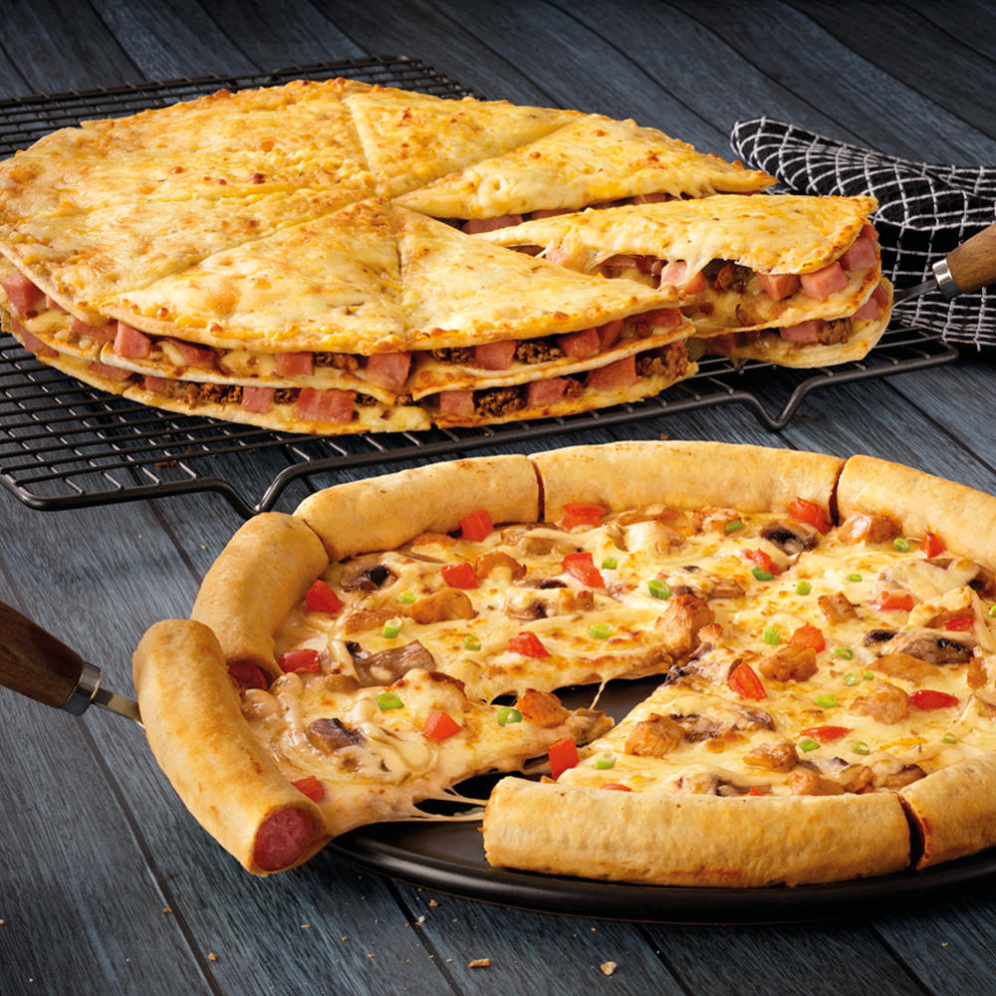
Take-Aways
Malawi is trending towards fragility and failure
And there is no self-correction mechanism in sight
There is no substitute for economic transformation and industrialization
Only two options exist: transform and industrialise, or perish
Government Intervention Is Critical For Industrialisation
In history, not a single country has industrialised otherwise
4. Tough decisions must be made … sooner rather than later … by “Malawians”
On the role of the state
On financing private sector investment and monetary policy
On financing public sector investment (and consumption!)
On trade and foreign exchange earnings
On the attitude of a whole people

Slide 3
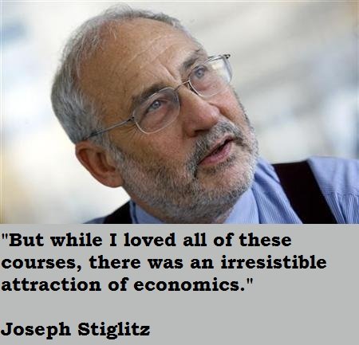
“The problem is a lot of what is called economics is not economics. It is more ideology or religion.”
Joseph Stiglitz

Slide 4
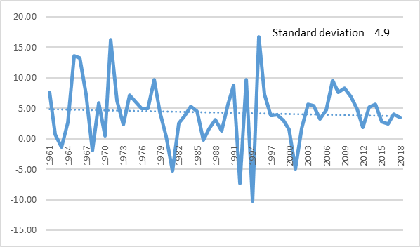
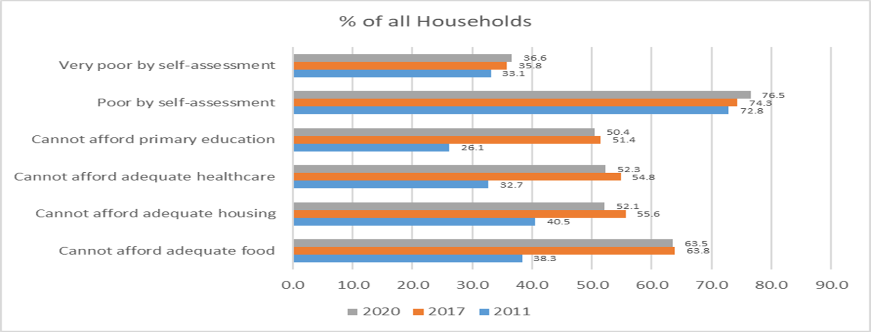
Malawi: trending towards fragility and failure
Malawi is getting poorer!
 | 1964 - 1980 | 1981 - 2018
GDP growth (average % p.a.) | 6.1 | 3.6
Per capita GDP growth (average % p.a.) | 3.3 | 0.8
Source: WDI
Growth has slowed down since 1981
Poverty Has Deteriorated Between IHS3 (2011) & HIS 5 (2020)
Real GDP Growth (% p.a.)

Slide 5
Malawi: trending towards fragility and failure
Malawi is getting poorer
The World’s Poorest Countries (By GDP/Capita, PPP)
Rank | 2019* | 2015** | 2010***
10 | Chad | Comoros | Afghanistan
9 | Eritrea | Madagascar | CAR
8 | Liberia | Eritrea | Sierra Leone
7 | South Sudan | Mozambique | Eritrea
6 | Mozambique | Malawi | Niger
5 | Niger | Niger | Somalia
4 | Malawi | Liberia | Burundi
3 | D.R. Congo | DRC | Liberia
2 | CAR | Burundi | DRC
1 | Burundi | CAR | Zimbabwe
* https://www.worldatlas.com/articles/the-poorest-countries-in-the-world ** https://data.worldbank.org/indicator/NY.GDP.PCAP.PP.CD ***http://www.financialjesus.com/interesting-economics/top-10-poorest-countries-in-the-world-2010/#

Slide 6
Malawi: trending towards fragility and failure
Malawi is among the 50 most fragile countries in the world … Despite peace
Demographic pressure is our biggest risk factor: 44 million people by 2050!
Factionalised elites, weak economy and poor public services are huge pressure points
We are also vulnerable to external intervention, and risk brain drain
COVID-19 is but additive to a perpetual national crisis
Fragile States Index: 2017 - 2021
Year | Rank (of 178) | Total (Max =120) | Security Apparatus | Factionalized Elites | Group Grievance | Economy | Economic Inequality | Human Flight and Brain Drain | State Legitimacy | Public Services | Human Rights | Demographic Pressures | Refugees and IDPs | External Intervention
2021 | 46 | 83.2 | 4.8 | 8.4 | 4.7 | 7.7 | 8 | 6.8 | 7.1 | 8.2 | 5.3 | 9.4 | 5.4 | 7.4
2020 | 43 | 84 | 5.1 | 8.1 | 5 | 7.7 | 8.1 | 7.1 | 6.6 | 7.9 | 5.6 | 9.4 | 5.7 | 7.7
2019 | 49 | 83.3 | 4.8 | 8.1 | 5.3 | 8 | 8.1 | 7.4 | 6.1 | 8 | 5.9 | 9.1 | 5.2 | 7.4
2018 | 47 | 85.5 | 4.5 | 8.1 | 5.6 | 8.1 | 8 | 7.7 | 6.4 | 8.3 | 6.2 | 9.4 | 5.5 | 7.7
2017 | 44 | 88 | 4.8 | 8.1 | 5.6 | 8.4 | 8.3 | 7.9 | 6.4 | 8.6 | 6.2 | 9.7 | 5.8 | 8.2
Average | 46 | 84.8 | 4.8 | 8.2 | 5.2 | 8.0 | 8.1 | 7.4 | 6.5 | 8.2 | 5.8 | 9.4 | 5.5 | 7.7

Slide 7
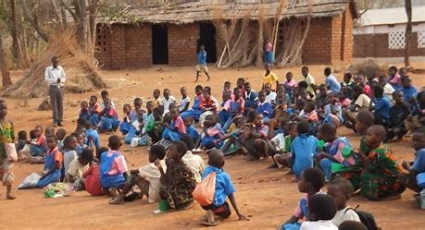
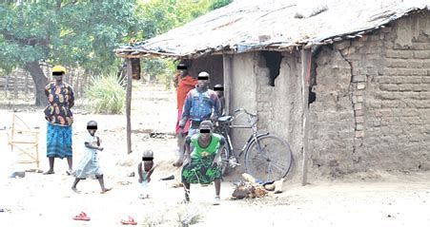
The worsening trend of fragility and impoverishment will not correct itself
“The fault…is not in our stars, but in ourselves.”
Cassius in Shakespeare’s Julius Caesar

Slide 8
There Is No Substitute For Transformation Towards Industrialization
Industrialisation equals development
“The fact that the term ‘industrialised countries’ is used synonymously with ‘developed countries’ implies that industrialization plays a major role in development and sustained economic diversification” Alemayehu (2000)
Development requires sustained economic growth
Growth is a critical pathway out of poverty; critical for expanding education, health, nutrition & survival across populations (WEF, 2019)
Effective and sustained growth requires economic transformation
Requires the movement of excess labour from land (agriculture) to factories (Lewis, 1954; Singer, 1979; Dethier and Effenberger, 2011)
Addresses declining land holdings: average farm size has shrunk by 50% since 1971
Options: Industrialise and transform, or perish!

Slide 9
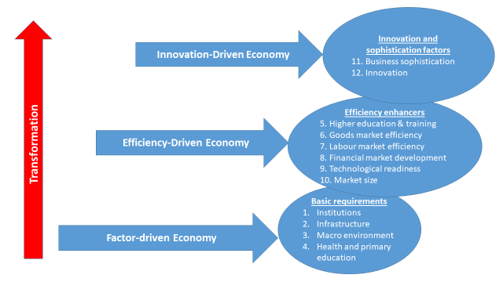
There Is No Substitute For Transformation Towards Industrialization
The road to transformation & industrialization ≠ rocket science (WEF, GCR, 2012)
The sequencing is generally cast in stone!

Slide 10
Government Intervention Is Critical For Industrialisation
“ … it is a fallacy that early industrializers could have developed their industrial sector without infant industry protection … The United States was the motherland of infant industry protection …., its (Great Britain’s) industrial sector benefited from trade protection and other forms of government intervention in the trade flow through the Navigation Act and by means of political power and even military power … even when the industrial sector was mature, protection was used as a means of bargaining power in bilateral trade negotiation and trade treaties” Shafaeddin (1998)
Government intervention in the USA, UK, Germany and France was used to:
Influence the direction of trade
Assist capital accumulation
Develop institutions
Build infrastructure
Facilitate research and development initiatives

Slide 11
Government Intervention Is Critical For Industrialisation
The Chinese model of industrialization suggests that political stability, trade openness and domestic market liberalization are critical for late-comers
Labour-intensive production crucial in reducing poverty and achieving competitiveness
Yet even the Chinese model is government-driven
And we have witnessed a period of historic China-Western trade wars
The Chinese model is not void of calculated protection
Malawi, therefore, needs home-grown solutions to achieve rewarding industrialization

Slide 12
Malawi’s Industrial Performance: Regression to Mediocrity
Malawi has been on that industrialisation road before!!
By the 1960 -1992 trend, Industry should be contributing upwards of 60% to GDP!
Contribution to GDP (%)
 | 1960 | 1990 | 2019
Industry | 13.3% | 39.2% | 20.1%
Agriculture | 48.4% | 38.5% | 25.5%
Services | 38.3% | 22.3% | 54.4%
2017 ⇒ Agriculture = 26.1%; Manufacturing = 9.4%; Services = 52.4%
The privatisation effect!

Slide 13
Industry’s Contribution To Employment Is Insignificant & Declining
Contribution to employment (2019)
Agriculture = 72%
Services = 20%
Industry = 8%
“Trade liberalisation killed local industries and jobs. The loss of market-share by local products forced many local-firms to close down. Tens of thousands of jobs evaporated. The government watched helplessly as the economy nose-dived and big employers like BAT, Unilever, clothing-factories, Band C and PEW closed down, scaled-down their manufacturing operations or went belly-up. It became cheaper and more profitable to import finished-products than to make them here”
Tom Sangala (2015)

Slide 14
Government has failed to get the basics sustainably right
Factor-driven economy: primary attention Should be to get these basics right
Institutions, infrastructure, the macro-economy, basic health services, basic education
Institutions to protect the interests of powerful road transporters, Malawi brings fuel at high cost from the sea bail can dubiously be granted to the convict of attempted murder Factionized elites render Malawi fragile (Average Fragile States Index = 8.2 of 10)
Infrastructure Malawi ranks 171 of 190 countries on getting electricity in the DBI 2020
The macro-economy Gross official reserves only at 1.6 months of imports by end June 2021 (2 months by end June 2020) The exchange rate moved from K730/$ in January 2019 to K813/$ in August 2021 The maximum lending rate is 23.4% against a reference rate of 12%
Education and health (human resource development) Primary school completion rate is only 51.2; secondary school is 22.1 In 2013, Malawi had the 2nd lowest reading and mathematics scores among standard 6 pupils in SADC Poor public services render Malawi fragile (Average Fragile States Index = 8.2 of 10)

Slide 15
Tough Decisions Must Be Made
What should be the role of the State in Production?
1964 – 1980s: significant state role; extraction
The triad’s commercial holdings, mid-1980s: ADMARC = 34; MDC = 27; Press = 40+ (Chirwa, 2000)
77 commercial SOEs or semi-SOEs, rose to 121 by 1992 (Magalasi, 2008; World Bank, 1994)
1984 – 2002: Privatization of government assets; SOEs
Initially parastatal reforms, asset swaps, divestitures and disposal
Privatisation Act (1996)
53 SOEs privatized by 2002
Government struggles to meet commitments with the private sector; arrears
2011 – date: The private sector can’t do it alone, after all!
Privatisation Commission becomes PPPC in 2011: regression to mediocrity!
Government risks huge challenges to meet future commitments with the private sector
“Government intervention is critical for industrialisation and transformation”
The privatization agenda is a miserable flop – only transferred assets into private hands for a song!
Extraction (rent-seeking) is the thing to address through a system of sanctions and rewards
Notes:
In u

Slide 16
Tough Decisions Must Be Made
How should Malawi finance public sector investment?
Malawi is a signatory of the SADC Industrialisation Strategy and Roadmap (2015 – 2063)
To double regional share of manufacturing from 15% to 30% by 2030, and to 40% by 2050
To increase regional share of manufactured exports from 20% of total exports to 50% by 2030
To increase the share of industrial employment to 40% of total employment by 2030
Malawi stands to profit from “walking the talk” on a SADC commitment
Achieving industrialization and transformation faces resource constraint
Financing gap in Malawi was estimated at 19.3% of GDP in 2014
Annual total financing requirement estimated at 25.6% of GDP
tax revenue has averaged 13.1% of GDP p.a. during 1970/71 – 2019/20
From 17% to 11% after GDP rebasing; below SADC average of 25.9%; looming trouble for the tax-payer
It is currently not feasible for the economy to realise this level of financing, and every day that passes without duly addressing economic growth concerns is costly and disastrous
Notes:
In u

Slide 17
Tough Decisions Must Be Made
How should Malawi finance public sector investment?
Criticism against deficit-budgeting by orthodox economists is dangerous and damaging
Capital account deficit is a necessary stimulant with idle resources (Keynes, 1936; Lerner, 1943)
Austerity poses a worrisome limitation on the government’s ability to pursue public purpose (Armstrong, 2019)
There is nothing characteristically bad about government borrowing; macroeconomic policies must reflect pragmatism rather than consistency with some traditional doctrine; and excessive aversion to public debt may lead to bad policies Armstrong (2019)
Austerity usually killed formal-sector jobs, depressed economies’ effective demand, led to massive disinvestments in weak manufacturing sectors, and rewarded the financial sector more than the real, fiscal and external sectors of the domestic economy … social inequality ultimately worsened. Because the ardently alleged ‘crowding out’ of private investment by government spending was not truly responsible for the low level of investment, the budget cuts did not spearhead private sector growth Watkins (1995); Mangani, 2021)
What is wrong with us is that we borrow for consumption, do not rationalize expenditures, and steal!
Notes:
In u

Slide 18
Tough Decisions Must Be Made
How should Malawi finance private sector investment?
What should be the stance of monetary policy?
what is the stance … and real value of “macro stability”?
Private sector credit did not improve significantly in 2020
Credit to government increased by K85.0 billion to K1.1 trillion
Credit to private sector increased by K25.6 billion to K638.2 billion
Reserve Bank of Malawi, 2020
Notes:
In u

Slide 19
Tough Decisions Must Be Made
How should Malawi finance private sector investment?
What should be the stance of monetary policy?
what is the stance … and real value of “macro stability”?
Malawi must transform from a regime overly preoccupied with growth-dampening macroeconomic stability into one that is growth-focused and export-oriented
Would grow a competitive industrial sector
Would build adequate reserves necessary for achieving stability on the foreign exchange market
Requires more than a “referee” central bank; more that moral suasion
Notes:
In u

Slide 20
Tough Decisions Must Be Made
How should Malawi address the forex challenge?
My Dos
Do graduate from tobacco
Should have seen the signals since WHO FCTC (2003)
Buyer’s market: Prices declining, mean-reverting
Even Philip Morris says no, hence FFSFW
Buyers are discouraging smallholders already
Do find a more impactful alternative
Needs thorough analysis
Do to it what we did with tobacco - institutions
Do use trade remedies to protect domestic industry
Anti-dumping, counter-veiling
Perfectly acceptable under trade agreements
Do rationalise imports
My Don’t
Don’t touch the minerals now; we have huge capacity gaps!
We need a critical mass of professionals in the science
We need a comprehensive fiscal regime
We need the capacity to negotiate in national interest
We need to address rent-seeking!
Notes:
In u

Slide 21
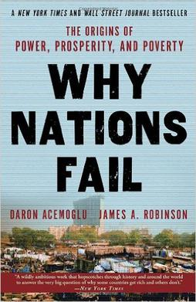
Tough Decisions Must Be Made
How may the attitude of a people be re-shaped?
By exacting commensurate reward for good performance, and commensurate punishment for wrong-doing (the right incentive structure)
Facilitates proper risk-return trading (Markowitz, 1952) in all conduct
Get this wrong, and you have all sorts of problems: institutional failures
Only through a functional state
The attitude of a people is shaped by the state, “the (only) institution with the coercive capacity to impose order, prevent theft and fraud, and enforce contracts between private parties”
Acemoglu & Robinson (2012)
“an incorrect risk premium is the architect of doom”
Notes:
In u

Slide 22
“We are the masters of our fate, the captains of our souls, because we have the power to control our thoughts”
Napoleon Hill
Only Malawians can … and must … remodel their economy into shape for a better tomorrow

Slide 23
TX
zikomo

