Slide 1
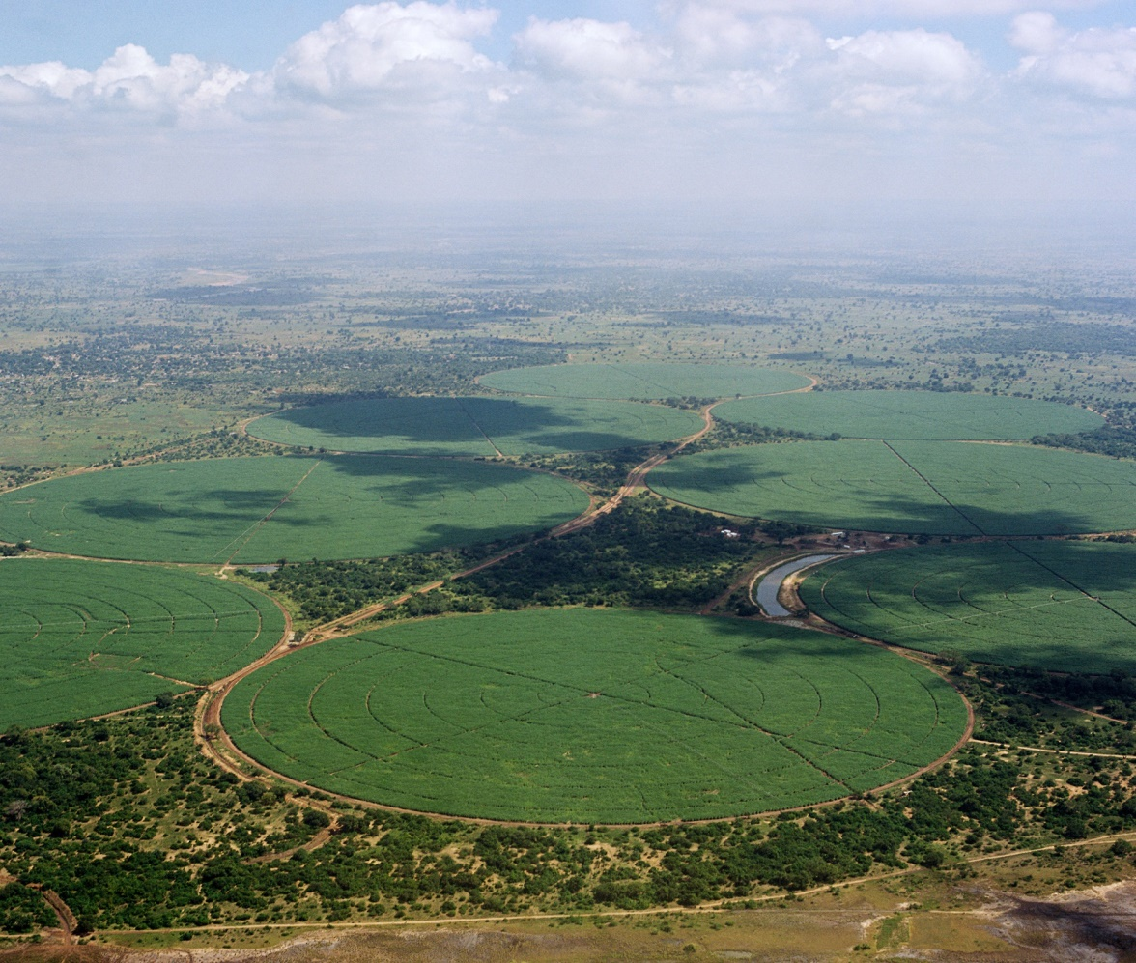
LEADING OUTSIDE THE BOX
Presented by:
Lekani Katandula

Slide 2
The foundations
What is leadership?
What then would outside the box leadership mean?
Who needs leadership and why?
Why and how do we exercise outside the box leadership?

Slide 3
The journey to Self and entity out of the box leadership
Start with Why.
A clear purpose
Know your stakeholders and their needs
Aim for effective engagement of stakeholders
Engaging employees
1
2
3
4
Engaging other stakeholders
Engaging Government and regulators
Engaging your suppliers
Engaging your customers
8
7
6
5
Engaging your shareholders
Defining your vision and strategy
Effective execution with proper LMC
Conducting PIRs and returning to step 1
9
10
11
12

Slide 4
What else should we look out for?
Are we personally growing?
Are our families/teams growing with us?
Are we regularly in touch with our stakeholders and responsive to both their needs and our own needs?
Are we harnessing the power of the collective genius?

Slide 5
What else should we look out for?
Are we growing our talent and leadership bench?
Is our entity growing and getting better regardless of the environment?
Are we positively impacting the environment (both regulatory and ecological)?
Are we adequately networked and leveraging on wider information sources?

Slide 6
Let’s engage
SWEET QUESTIONS & COMMENTS ARE WELCOME

