Slide 1
DIGITAL FINANCIAL SERVICES
By
John Kapito
Executive Director
Consumers Association of Malawi

Slide 2
Introduction - 1
What is Digital Financial Services (DFS)?
Broad range of financial services accessed and delivered through digital channels,
These include payments, credit, savings, remittances and insurance – through digital channels.
What are Digital channels
refers to the internet, mobile phones, ATMs, POS terminals etc.
DFS concept includes mobile financial services (MFS)

Slide 3
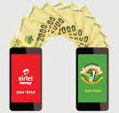
Introduction - 2
Unbanked Consumers are increasingly gaining access to financial services through digital channels and an emerging new sets of institutions such as agent network managers, payment aggregators and others who are helping to build out a more far reaching and efficient digital finance ecosystem.
The high cost of building and operating brick-and-mortar bank branches has been a major obstacle for extending financial services to the poor. Physical bank branches are expensive to maintain in far-flung communities, while traveling to urban areas is costly for many rural Consumers.
However, problems or barriers remain a long way to go in the digital finance. It should be mentioned that digital finance has also related risks.

Slide 4
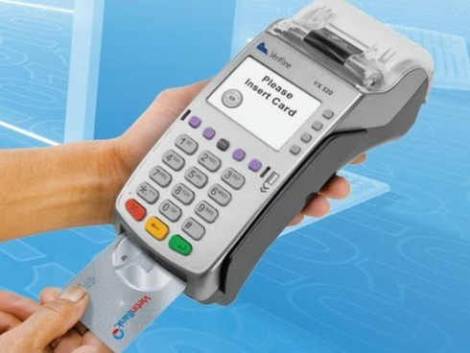
Benefits of Digital Financial Services (DFS)
Potential to provide affordable, convenient and secure banking service
Provides greater control of Consumer personal finance, quick financial decision making, and the ability to make and receive payments
Increases access to financial services through digital channels and an emerging new set of institutions
Allows a wider range of financial services such as online banking, mobile banking etc.
More convenient and affordable than traditional banking services

Slide 5
Benefits of Digital Financial Services (DFS)
Enabling low-income and poor Consumers in Malawi to save and borrow in the formal financial system
It is vital to Consumers as it boosts security for their cash
Speed up delivery, which is especially important in case of emergencies such as funerals and other disasters
Increase women’s economic participation
Creates a clear digital record and can be traced
Digital Financial services are easily accessible

Slide 6
Challenges of Digital Financial Services(DFS)
Lack of merchant willingness
High transactional costs
Inadequate Financial Literacy
Low level of active users (predominant dormant accounts) due to high service costs
Consumers unfamiliarity with services due to inadequate financial education
Low involvement of banks and non-banking enterprises for the development of more inclusive services

Slide 7
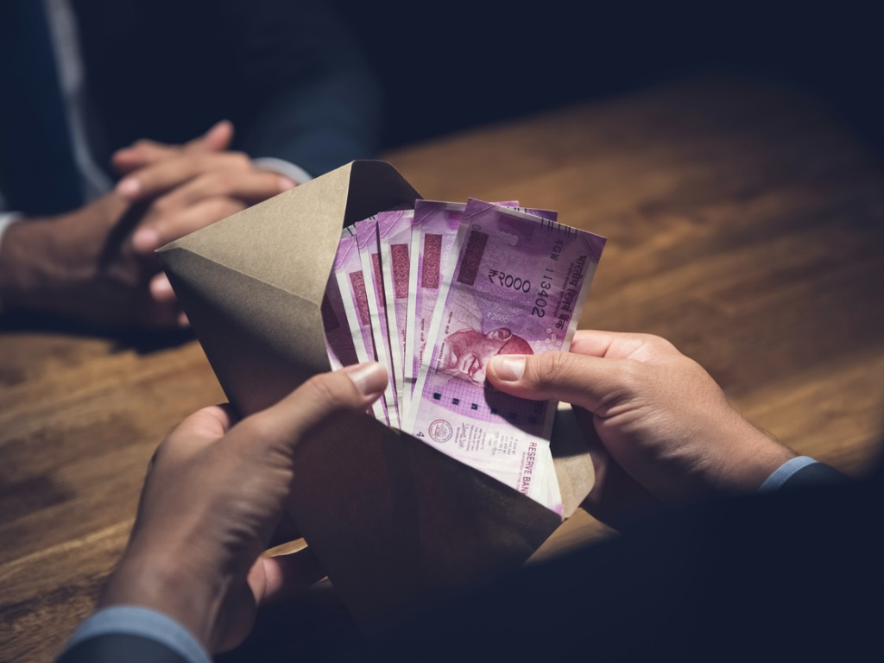
Challenges of Digital Financial Services (DFS)
Lack of political will – Government largest payer but not doing much in adoption
Low coverage and poor network in the country
Lack of infrastructure sharing (interoperability)
Inconsistency supply of electricity
Prevalence of corrupt practices for individuals to avoid trail

Slide 8
Risks of Digital Financial Services (DFS)
Lack and inadequate for strong Consumer education and consumer protection
promoting financial literacy
Prevalence of fraud prevention
dispute resolution mechanisms and data privacy
Agents and their networks introduce new operational risks, the risk of financial crime and the risks associated with Consumer credit
Contravening anti-money laundering and financing terrorism rules by keeping records and reporting suspicious transactions

Slide 9
Risks of Digital Financial Services (DFS)
Contributes to reducing transparency (such as pricing, conditions and remedies),
Abuse of Consumers (including excessive pricing), or insufficient attention to data
Lack of confidentiality on Consumers data
Disruption and loss of data, including payment instructions (e.g. as a result of deleting messages)

Slide 10
92-A person who uses a generic number or owns or intends to use a SIM card for voice telephony services shall register that generic number or SIM card with any electronic communications licensee or with the distributor, agent or dealer of the electronic communications licensee, authorized to provide or sell generic numbers or SIM cards. Any electronic communications licensee or the distributor, agent or dealer of the electronic communications licensee, shall__ (a) where a potential subscriber is a natural person, obtain and fill in a form the following information__ (i) the full name of the subscriber; (ii) the identity card number, or any other document that proves the identity of the subscriber; and (iii) the residential and business or registered physical address of the subscriber,
COMMUNICATIONS ACT-2016 SECTION 92

Slide 11
Thank you for your attention

